Slide 1
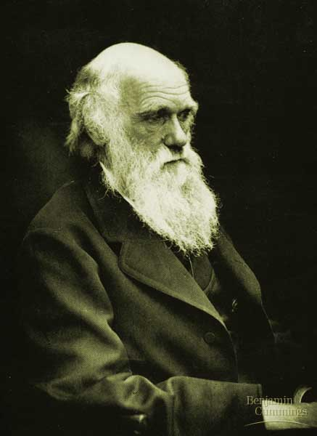
Unit 4 Evolution
Evolution: the change over time of the genetic composition of populations
Natural selection: populations of organisms can change over the generations if individuals having certain heritable traits leave more offspring than others (differential reproductive success)

Slide 2
Pre-Darwinian View
The Earth was only a few thousand years old, populated by unchanging life forms, made by the Creator during a single week.
Darwin’s conclusions challenged the root of Western Culture.

Slide 3
Important Scientific Ideas Prior to Darwin
Carol Linnaeus --Found order in the diversity of all life.
George Cuvier --Founded the study of Paleontology.
James Hutton --Gradualism - profound change is a the product of slow but continuous processes. (eg. erosion)
Charles Lyell-- Uniformitarianism suggested that the landscape developed over long periods of time through a variety of slow geologic and geomorphic processes.

Slide 4
Charles Lyell’s Influence on Darwin’s View
Lyell’s Principles of Geology caused Darwin to reflect that the Earth was not static and was much older than the current view

Slide 5
Alfred Russel Wallace’s Influence
His theory of natural selection (1858) was almost identical to Darwin’s
sent a copy of his work to Darwin for evaluation
Darwin published The Origin of Species the next year
Darwin is considered the main author of the idea.
Thomas Malthus’ Influence
- Wrote an essay on the results of overpopulation

Slide 6
LaMarck’s Theory of Evolution
1. Use and disuse
Structures used a lot will become better.
2. Inheritance of Acquired Characteristics
Modifications can be passed on.
Support for the theory:
a. tried to account for fossil evidence
b. emphasized the great age of the earth
c. stressed adaptation as a product of evolution.

Slide 7
Problems With LaMarck
a. Implies the organism can control evolution.
b. Aquired characteristics cannot be inherited.
c. not verifiable by experiment
August Freidrich Weismann, disproved Lamarck’s theory by cutting off the tails of mice and allowing them to reproduce.
The acquired feature of NO Tail was not passed on.

Slide 8
Charles Darwin
ship’s naturalist on HMS Beagle in 1831
ship’s mission was to chart the coastline of South America
Galapagos Islands - 1000 miles west of Ecuador
identified 13 distinct species of finches
Noticed that they were similar in some ways on all islands but different in ways that made them better suited to their own island. (Survival advantage)
Concluded they all had a common ancestor.

Slide 9
Descent with Modification (Darwin’s Key Idea)
5 observations of evolution in populations:
1- Exponential fertility –have lots of babies
2- Stable population – population change is low
3- Limited resources – can’t supply everyone
4- Individuals vary – individuals are different
5- Heritable variation – differences between individuals ca be passed to their babies
Result: Individuals with “best” features have more babies who survive so “best” is passed on.

Slide 10
Descent with Modification, II
3 Suggestions by Darwin:
1- If resources are limited then a “Struggle for existence” occurs
2- Non-random survival as “best” survive
3- Natural selection (best surviving means best have more babies and past their bestness on)

Slide 11
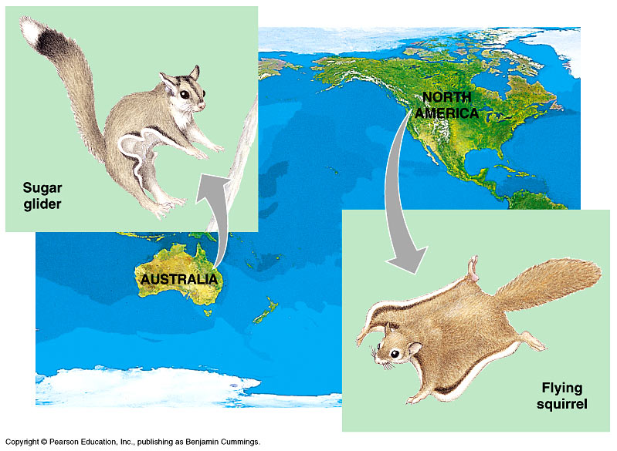
Evidence for Darwin and Evolution:
1) Biogeography
Different species are found in different places and the species have features suited for that place.
Examples:
-Islands vs. Mainland
-Australia vs. OtherContinents

Slide 12
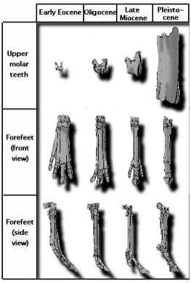
2) The Fossil Record
The gradual change of certain body parts can be observed over millions of years by looking at fossils of clearly similar looking creatures in the fossil record that get more and more different over time. While the creatures with the older forms disappear from the fossil record.
Horse Leg Bones

Slide 13
3) Comparative Anatomy
Homologous Structures
Body parts in different organisms that have the same evolutionary origin
Ex: bones in forearm of humans, frog, bat, porpoise, horse p.664.
a)Vestigial organs: body parts of no obvious present day use.
Ex: whale/snake hindlimbs; wings on flightless birds

Slide 14
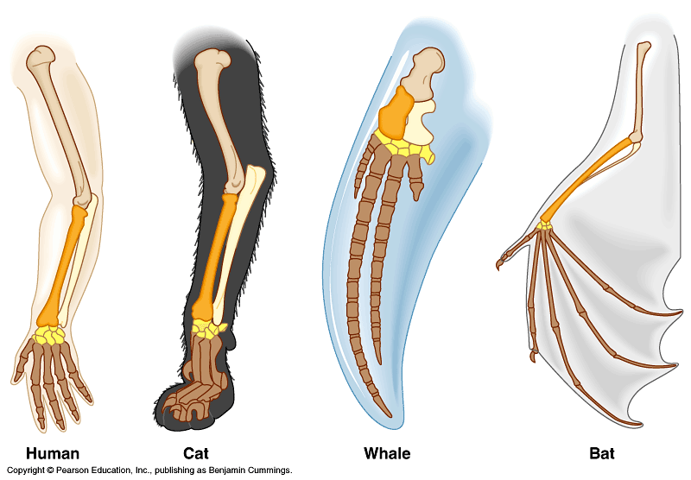
Homologous Structures

Slide 15
(iii) Comparative Anatomy
Analogous Structures
Body parts that do not have a common evolutionary origin but have similar function
Ex: wings of butterflies and bats.
Homologous structures means __________
Analogous Structures means ____________

Slide 16
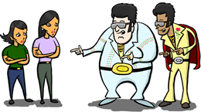
Which Pair is Homologous? Which Pair is Analogous?

Slide 17
Vestigial Traits in Humans
Ear-wiggling muscles Three small muscles around each ear that are large and important in some mammals, such as dogs, turning the ears toward a source of sound. Few people can wiggle their ears, and none can turn them toward sound.
Tail Present in human and all vertebrate embryos. In humans, the tail is reduced; most adults only have three to five tiny tail bones and, occasionally, a trace of a tail-extending muscle.

Slide 18
Vestigial Traits in Humans
Appendix Structure which presumably had a digestive function in some of our ancestors, like the cecum of some herbivores. In humans, it varies in length from 5–15 cm, and some people are born without one.
Wisdom teeth Molars that are often useless and sometimes even trapped in the jawbone. Some people never develop wisdom teeth.

Slide 19
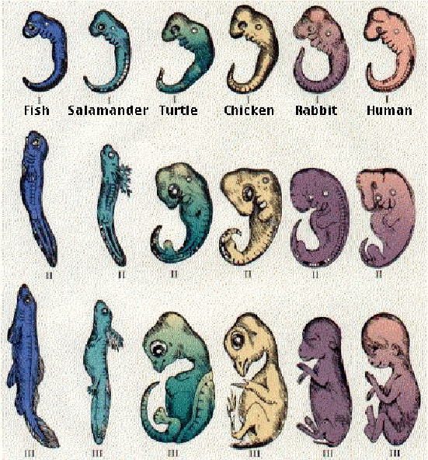
4) Comparative Embryology
Organisms are more
closely related if they
have similar stages of
embryonic development
Ex: Gill slits in
vertebrates, tails.

Slide 20
5) Heredity
Variations can be passed on to offspring and are required for natural selection
Governed by laws of inheritance

Slide 21
(6) Molecular Biology
Evolutionary relationships are reflected in gene sequences and proteins
Ex: Cytochrome c is a protein of 103-112 amino acids
-chimpanzees and rhesus monkeys are both primates and have 1 amino acid in the difference
- chimpanzees and horses are both mammals and have 11 amino acids in the difference

Slide 22
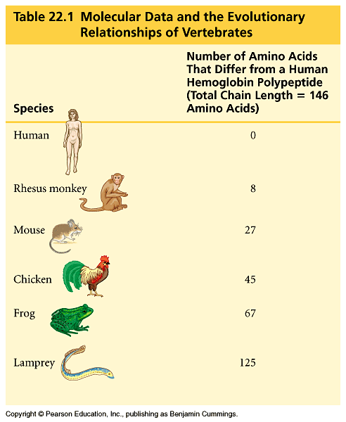
Similarities in DNA, proteins, genes, and gene products
Common genetic code within a species

Slide 23
An Example of Natural Selection:
English Peppered Moth (industrial Melanism)
two varieties, one light one dark
rare dark coloured are more easily seen by predators
industrial pollution “darkened” the landscape by the late 1800's
by early 1900's, population consisted of mainly/entirely of dark moths.

Slide 24
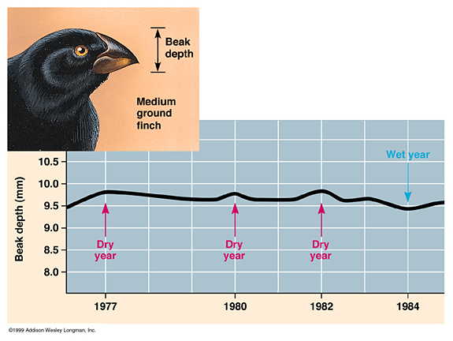
Another Example: BEAK EVOLUTION IN ONE OF DARWIN’S FINCHES

